Slide 1


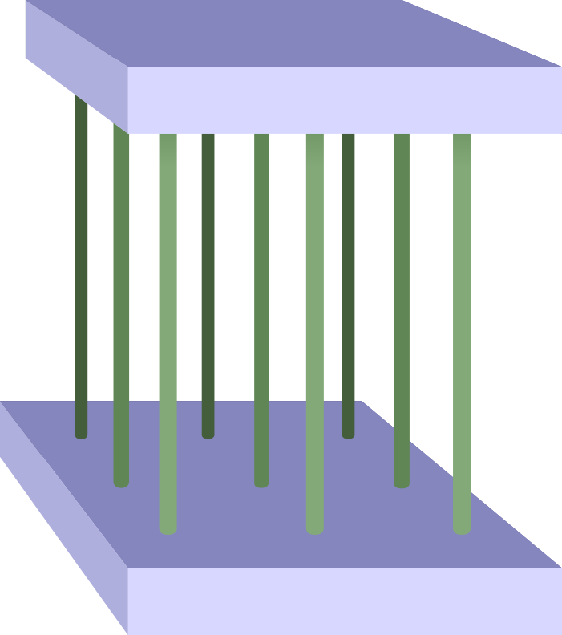
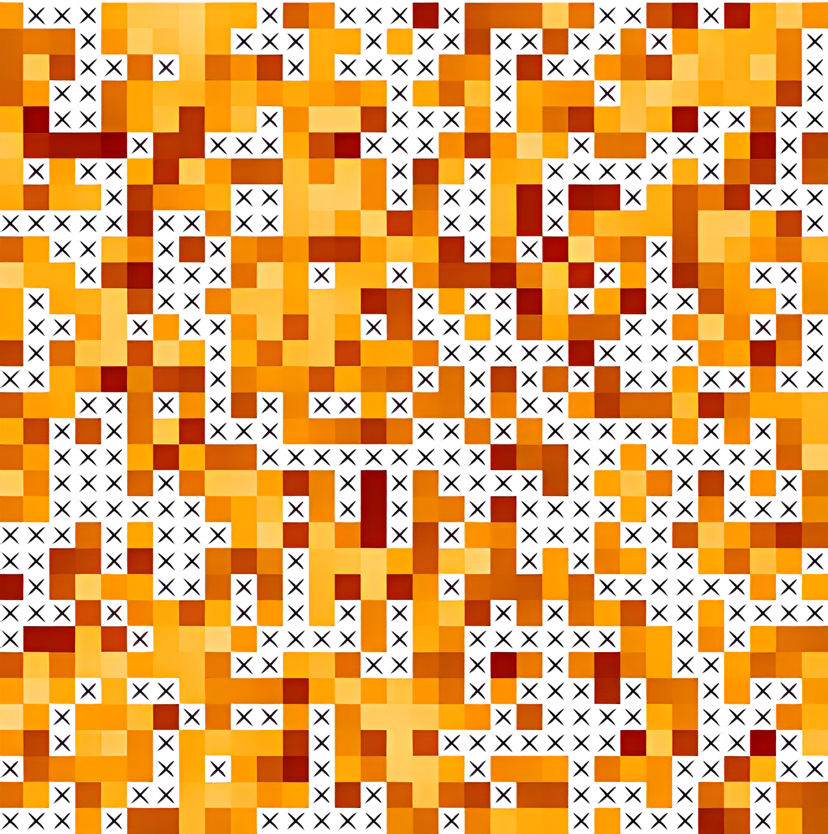
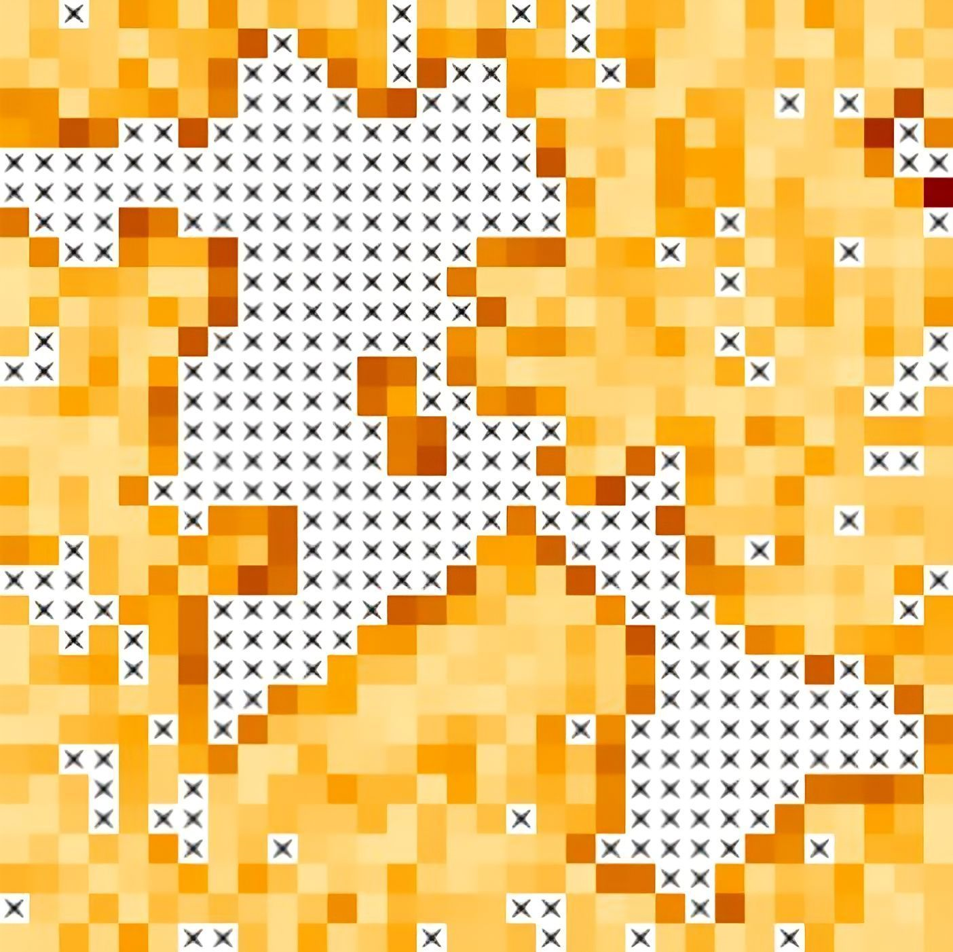



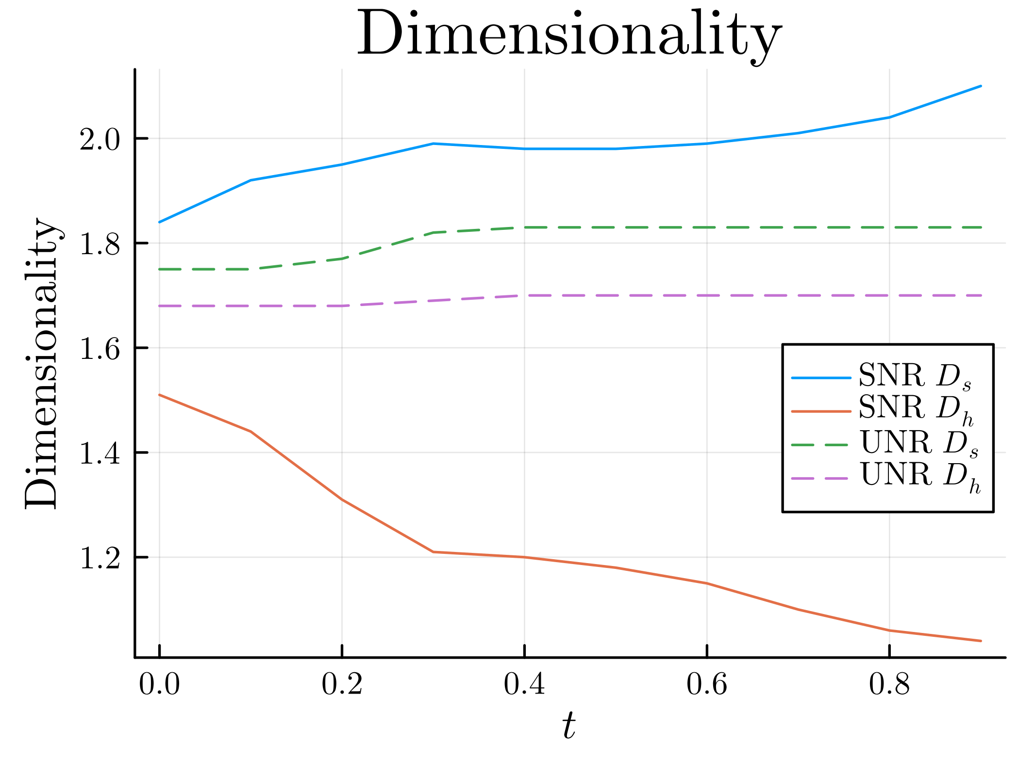
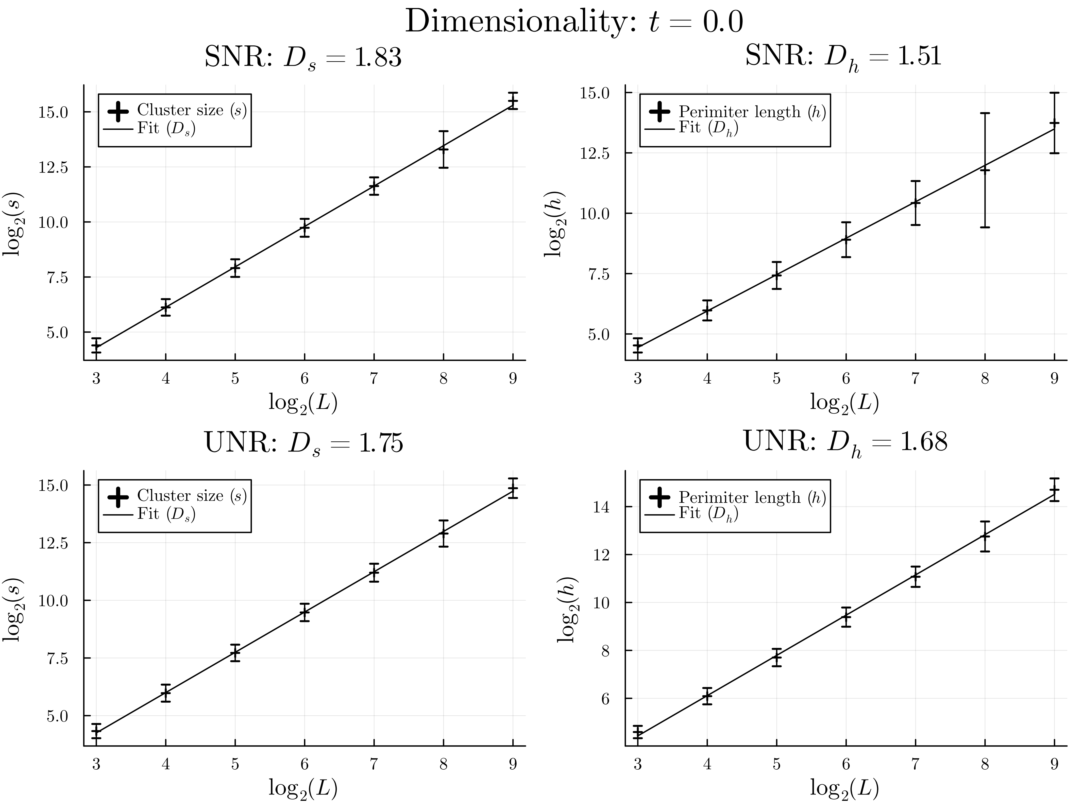
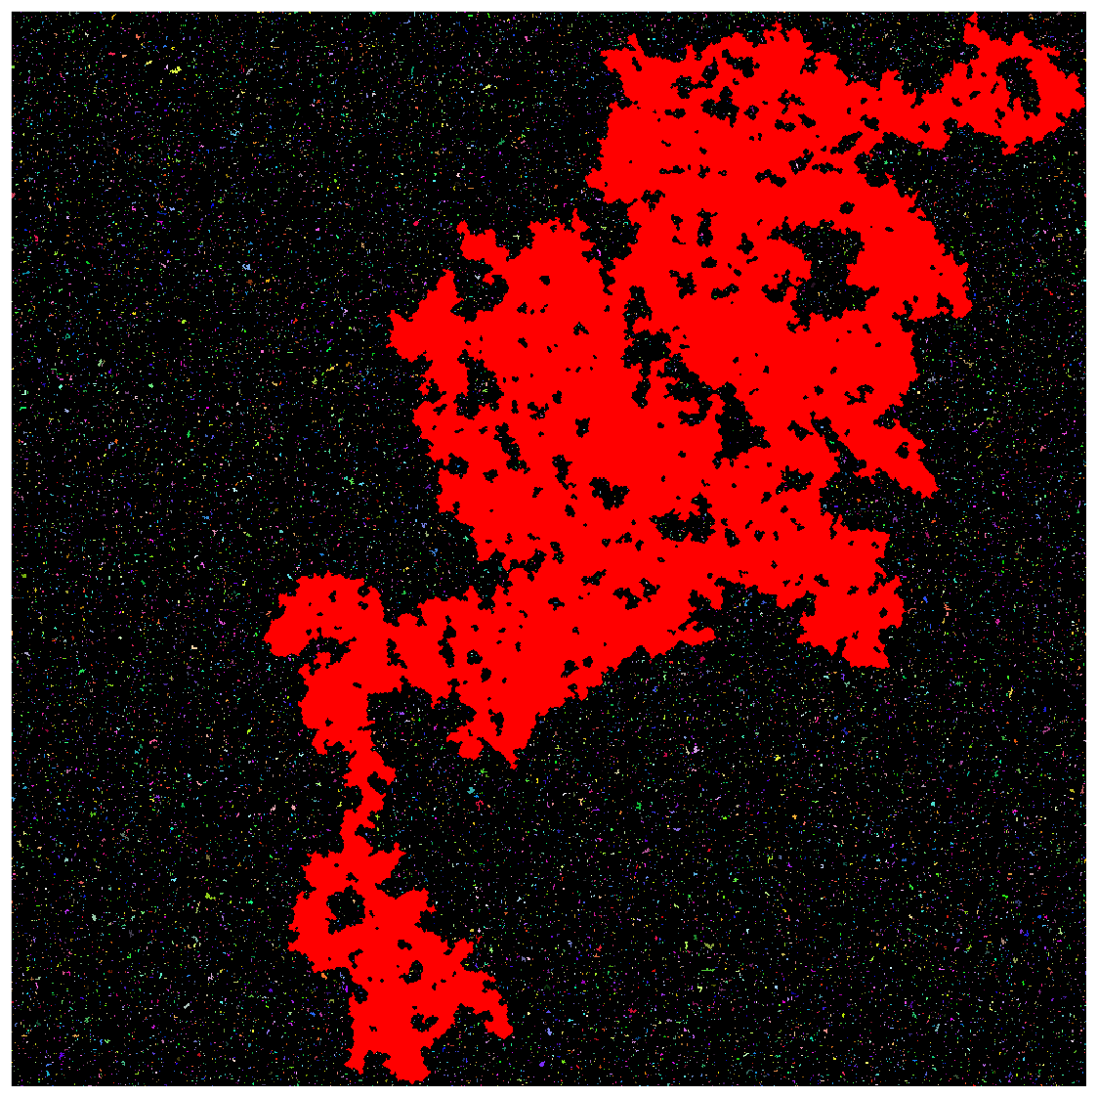
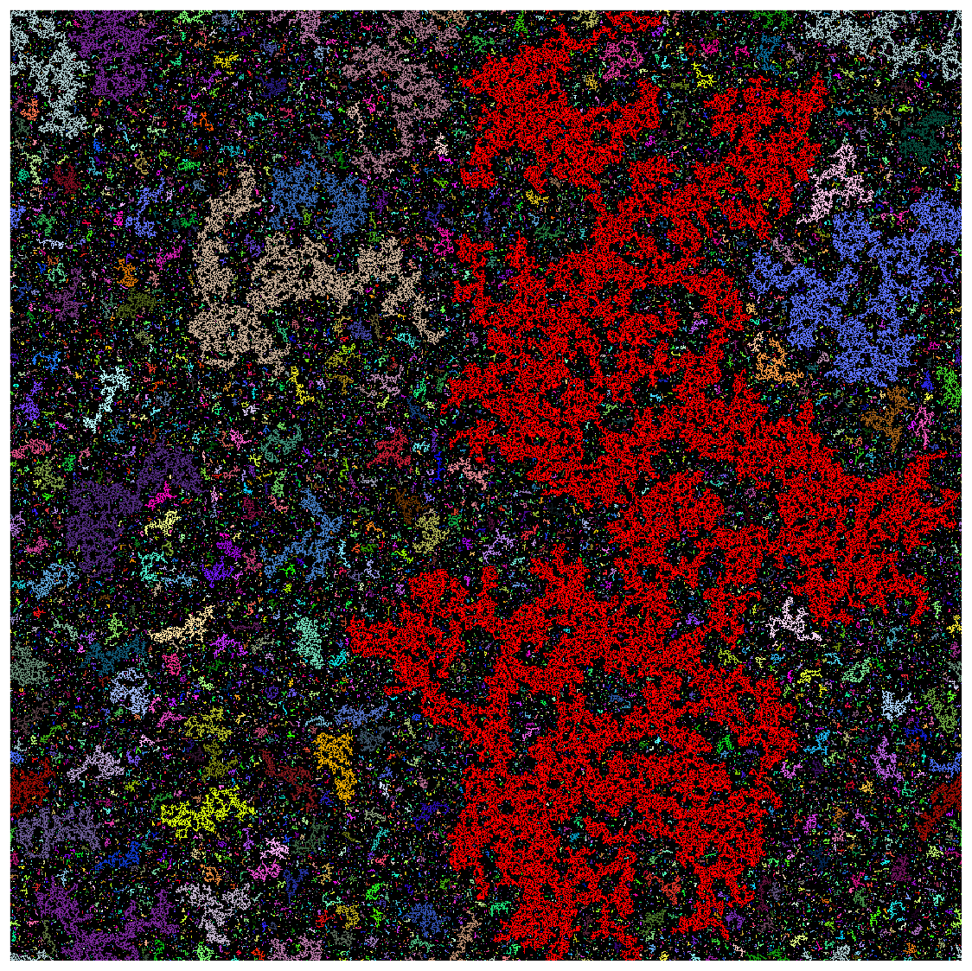
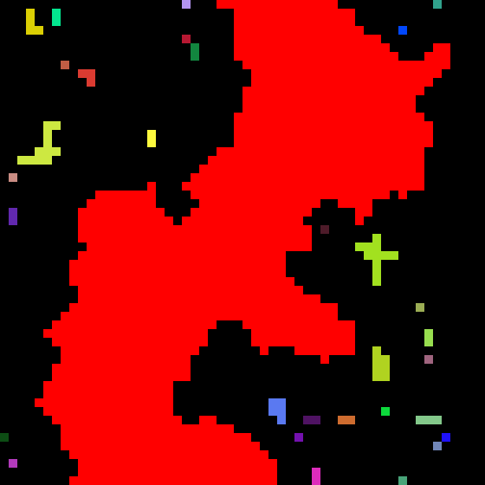
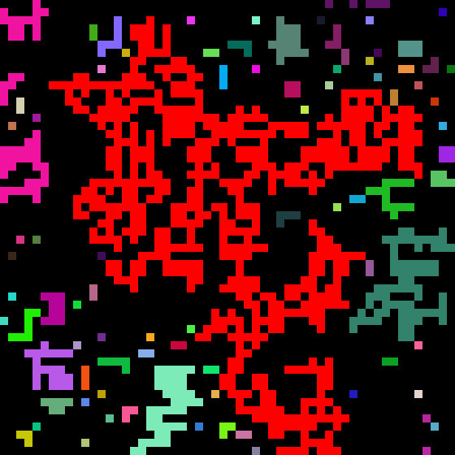

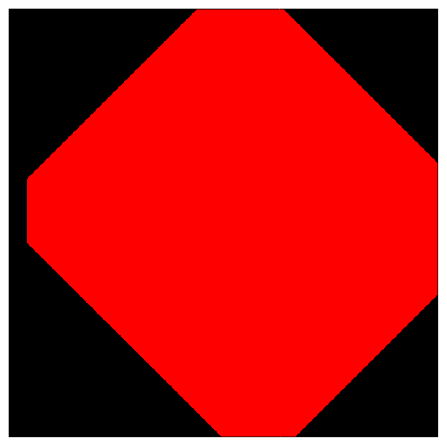
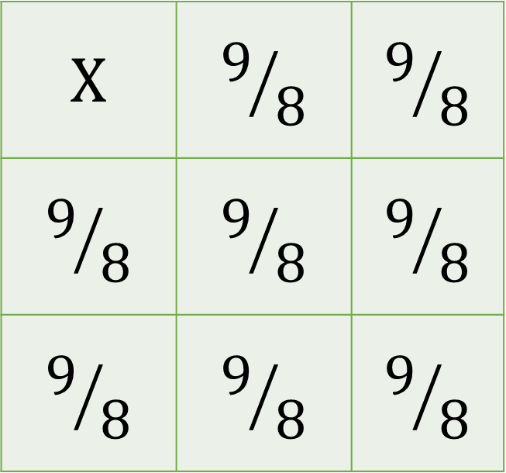
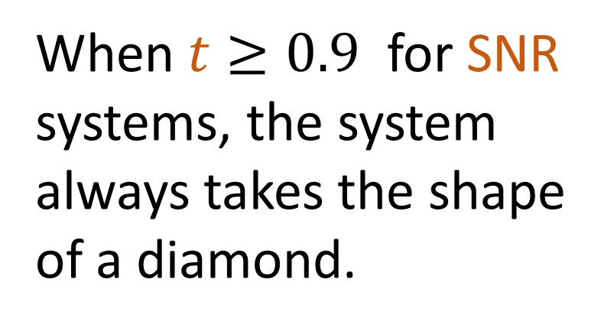
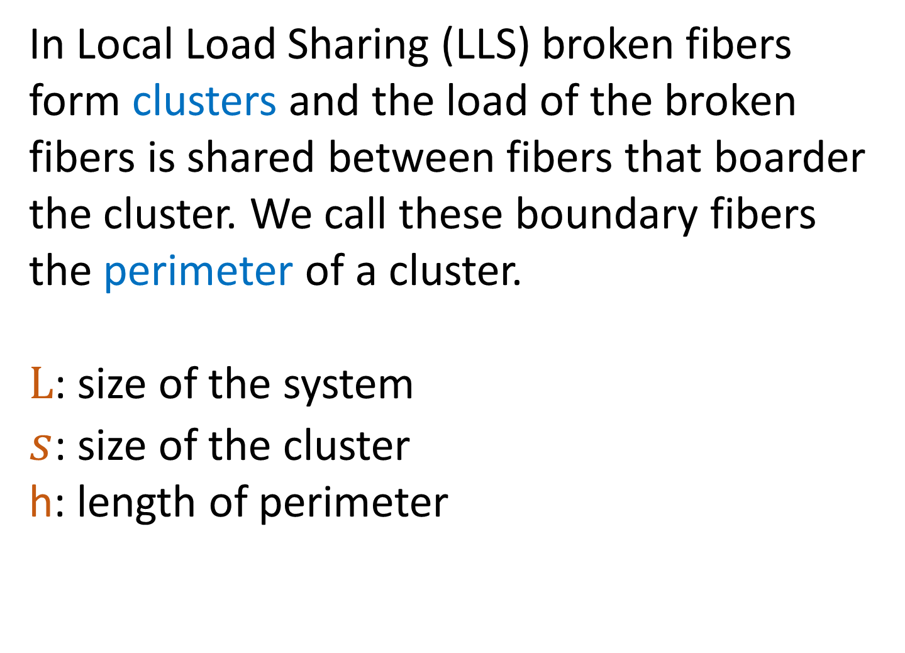
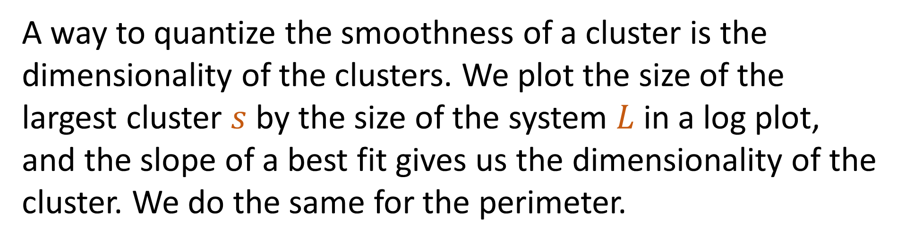
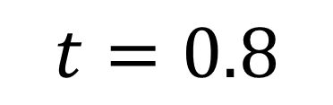
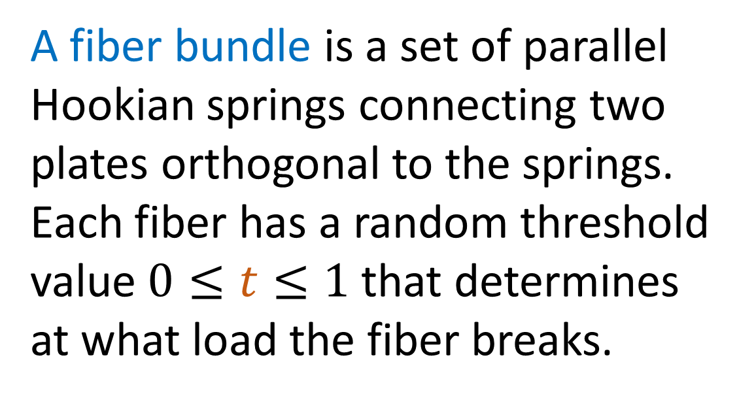
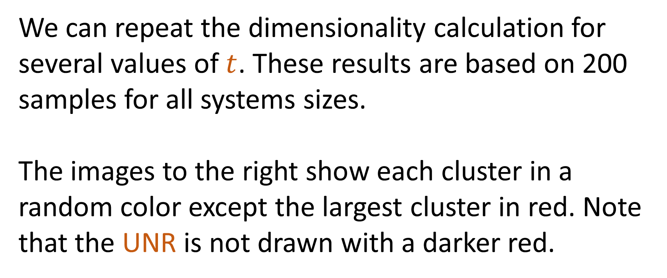
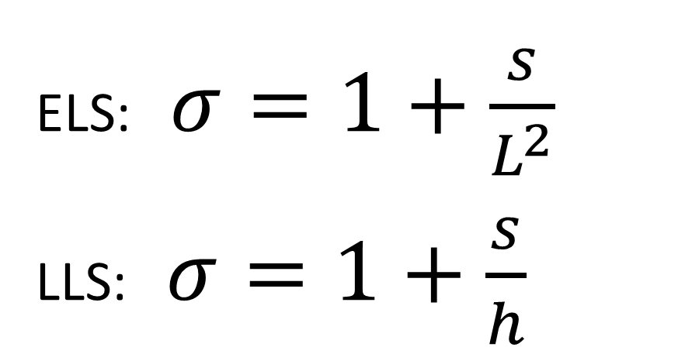
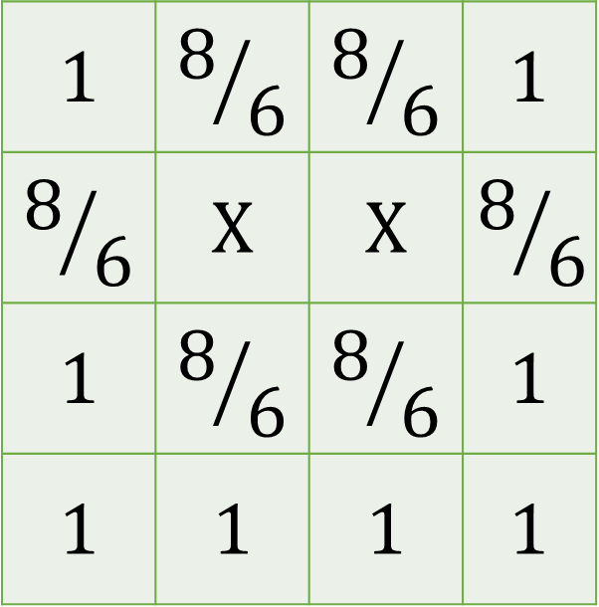
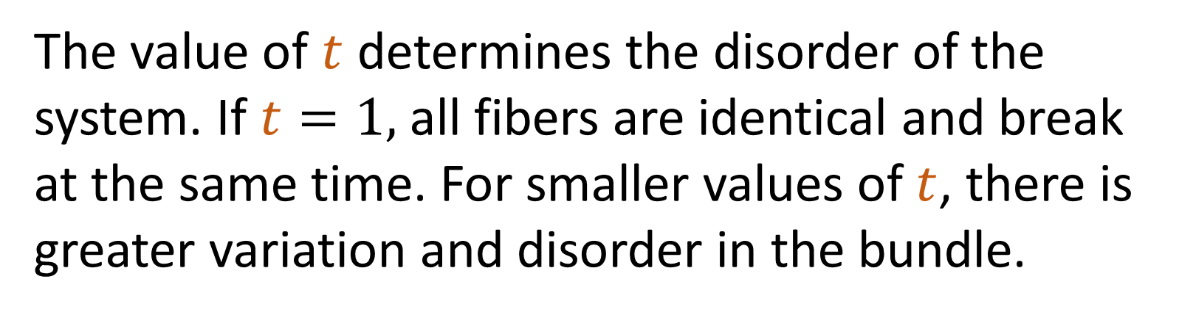
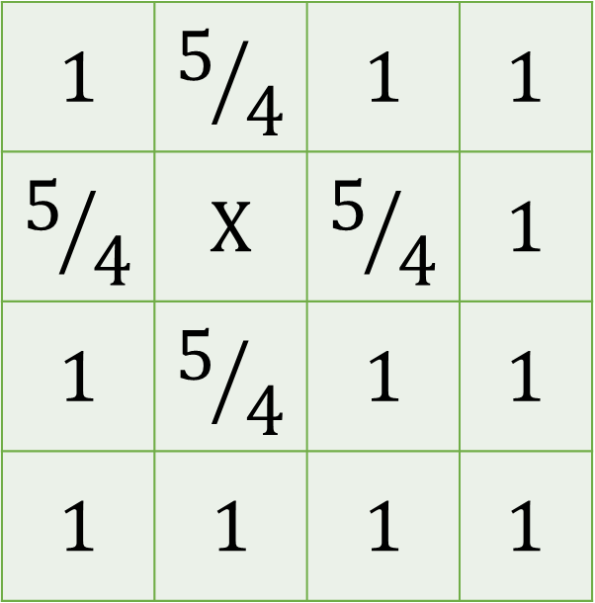
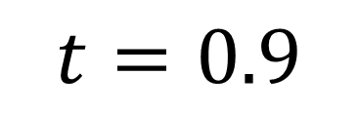
Stress concentration in the local load sharing fiber bundle model
Elias Lundheim¹, Santanu Sinha², Alex Hansen¹ and Jonas T. Kjellstadli¹
¹PoreLab, Department of Physics, Norwegian University of Science and Technology, NTNU, N-7491 Trondheim, Norway.
²Department of Physics, University of Oslo, P.O. Box 1048, Blindern, N-0316 Oslo, Norway.
NTNU
PoreLab
A. INTRODUCTION
The fiber bundle model is used as a statistical tool to model material stress and failure. We introduce changes to the LLS in hopes of giving the model properties that more closely resemble the real world.
A fiber bundle is a set of parallel Hookian springs connecting two plates orthogonal to the springs. Each fiber has a random threshold value $0≤t≤1$ that determines at what load the fiber breaks.
Local Load Sharing
In Local Load Sharing (LLS) broken fibers form clusters and the load of the broken fibers is shared between fibers that boarder the cluster. We call these boundary fibers the perimeter of a cluster.
$L$: size of the system
$s$: size of the cluster
h: length of perimeter
A: Standard (UNR)
ELS: $σ=1+\frac{s}{L^{2}}$
LLS: $σ=1+\frac{s}{h}$
Equal Load Sharing
There are different variations of the fiber bundle model. One variant is the Equal Load Sharing (ELS). When a fiber breaks, its force is distributed equally onto all other fibers.
The grids show the relative force σ on the fibers.
$$X$$ | $$9/8$$ | $$9/8$$
$$9/8$$ | $$9/8$$ | $$9/8$$
$$9/8$$ | $$9/8$$ | $$9/8$$
$$1$$ | $$5/4$$ | $$1$$ | $$1$$
$$5/4$$ | $$X$$ | $$5/4$$ | $$1$$
$$1$$ | $$5/4$$ | $$1$$ | $$1$$
$$1$$ | $$1$$ | $$1$$ | $$1$$
$$1$$ | $$8/6$$ | $$8/6$$ | $$1$$
$$8/6$$ | $$X$$ | $$X$$ | $$8/6$$
$$1$$ | $$8/6$$ | $$8/6$$ | $$1$$
$$1$$ | $$1$$ | $$1$$ | $$1$$
B. STRESS CONCENTRATION DETERMINED BY NEIGHBOURHOODS
B: SNR
In standard LLS, load is uniformly distributed on the perimeter of a cluster. We can rearrange this distribution depending on the number of neighbours.
UNR - Uniformly distributed neighbourhood rule
SNR - Stress enhancing neighbourhood rule
<
Summary
Introducing a neighbourhood dependance generates smoother clusters. Compare the situations depicted in figures A and B.
More neighbours Stronger fiber
C. DIMENSIONALITY
Disorder
A way to quantize the smoothness of a cluster is the dimensionality of the clusters. We plot the size of the largest cluster $s$ by the size of the system $L$ in a log plot, and the slope of a best fit gives us the dimensionality of the cluster. We do the same for the perimeter.
The value of $t$ determines the disorder of the system. If $t=1,$ all fibers are identical and break at the same time. For smaller values of $t$, there is greater variation and disorder in the bundle.
We can repeat the dimensionality calculation for several values of $t$. These results are based on 200 samples for all systems sizes.
The images to the right show each cluster in a random color except the largest cluster in red. Note that the UNR is not drawn with a darker red.
SNR
UNR
When$t≥0.9$ for SNR systems, the system always takes the shape of a diamond.
$$t=0.8$$
$$t=0.9$$
vemundlu@ntnu.no

